Slide 1

Home Log In Sign Up Contact Us
Welcome to Ⲥⲁⲃⲟ, your Coptic language learning resource!
Log in or create your account below!
Notes:
Welcome/Landing Page

Slide 2
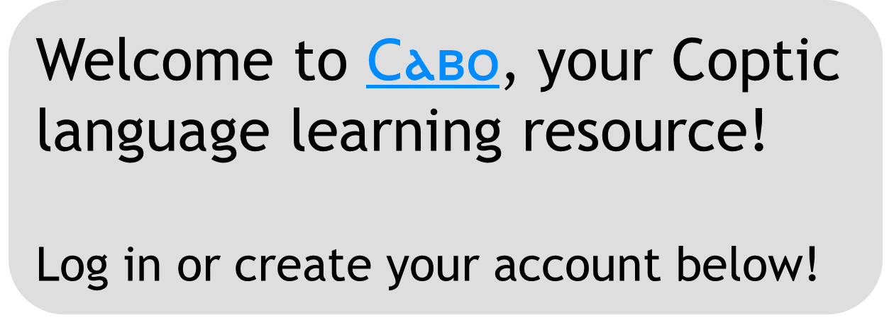
Home Log In Sign Up Contact Us
Log In:
Email
Password
Forgot password? Click here to reset password
New user? Create your account here!
Sign Up
Notes:
Welcome/Landing Page

